Slide 1
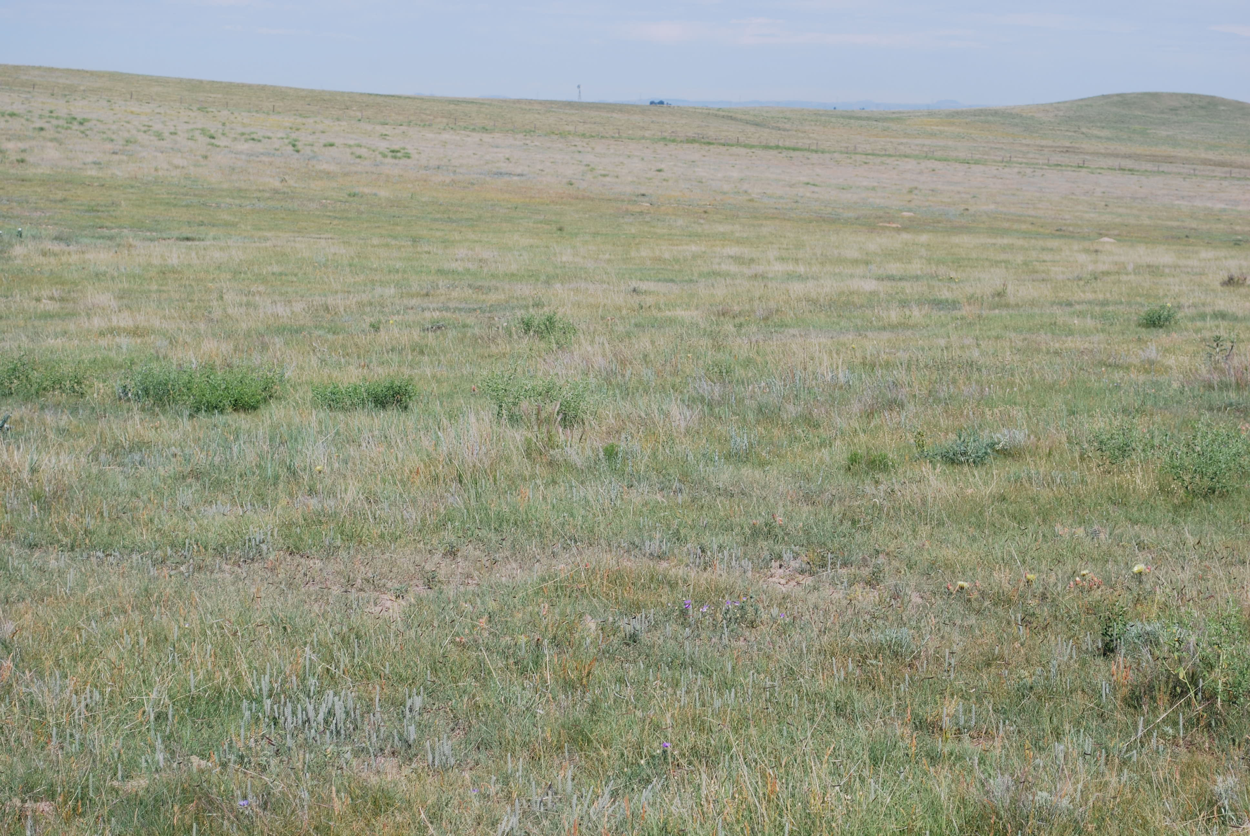
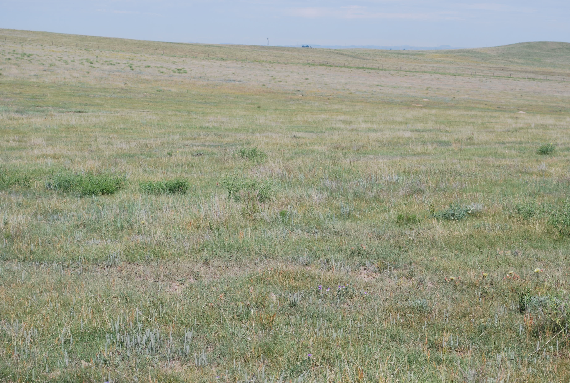
Soil Fauna
Victoria Veach
Mary Hunter-Laszlo
Lynn Moore
Gordon Brown
Kabir Peay
John Moore
July 23, 2010

Slide 2
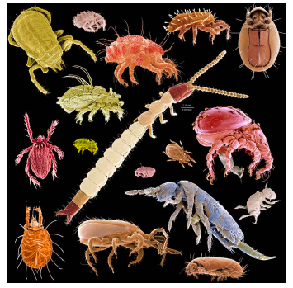
METHODS

Slide 3
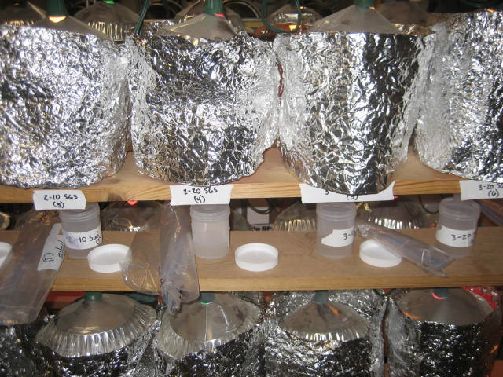
Arthropod Extraction
Materials:
Minimum 50g soil
Cotton Cheesecloth
Funnel with screen holding cheesecloth
Light source from above (Christmas tree lights)
70% Ethanol to catch arthropods
Foil
Procedure:
Break cores along natural fractures
Leave sample under heat source for 5 days

Slide 4
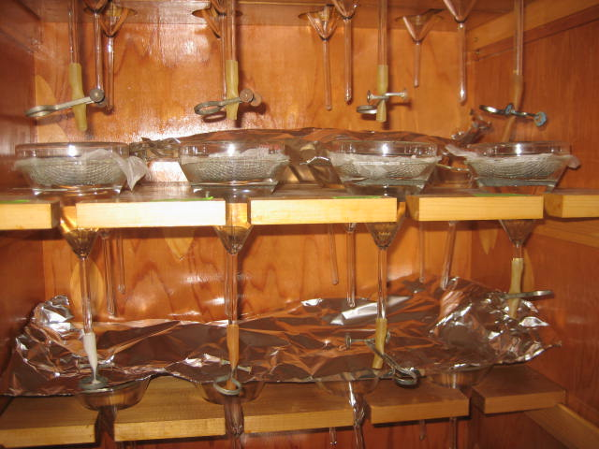
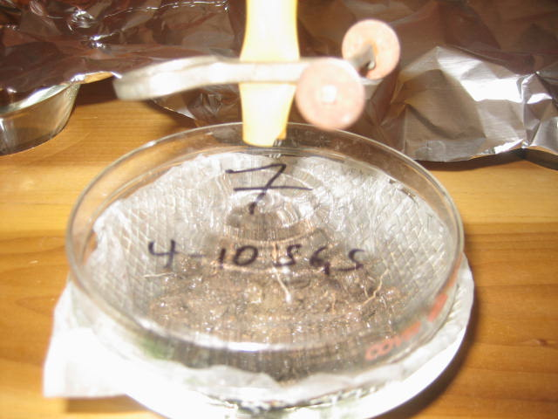
Nematode Extraction
Materials:
Longstem glass funnel
Scintillation Vials (20 mL)
Window screen with Kimwipe filter
5g soil sample
Formalin
DI water
Procedure:
Place 5g soil on filter
Add DI water until water touches bottom of filter
Nematodes collect at bottom of funnel
After 3 days, transfer nematodes to Scintillation vial. Add Formalin (final concentration 50/50)

Slide 5
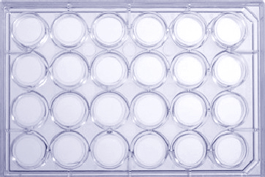
Protozoan Extraction
Materials:
10g soil sample
90 ml Protozoa Medium
24 well plate
5 test tubes with 9 ml soil extract
Sterile biotips and biotip gun
Procedure-Dilutions:
Plate will contain dilutions from 10⁻¹ to 10⁻⁶
Place 10g soil in 90 ml of medium. Shake for 1 min
Make serial dilutions in test tubes
Sample test tubes transferring 1 ml per well making 4 pseudo replicates
Feed with E. coli
Incubate for 5-7 days

Slide 6
Fungal & Bacterial Counts
Estimated using florescence microscopy
Counting of fixed area of slides using grid line intersect method

Slide 7
Assigned taxa/biomass to trophic guilds

Slide 8
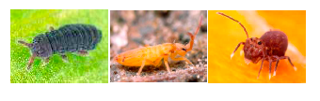
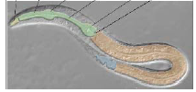
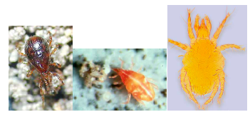
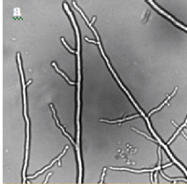
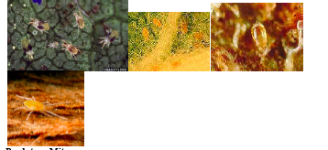
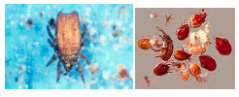
Looked at cool critters

Slide 9
RESULTS

Slide 10
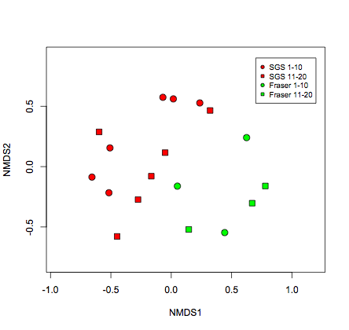
Community Ordination Plot

Slide 16
Shortgrass Steppe
Fraser Forest
0 – 10 cm
10 – 20 cm

Slide 17
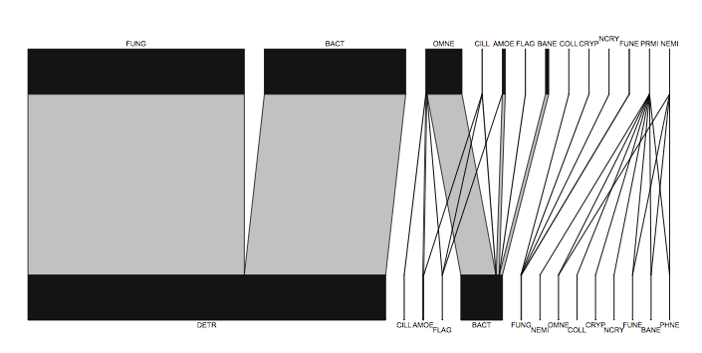
SGS 0-10 cm
Flux

Slide 18
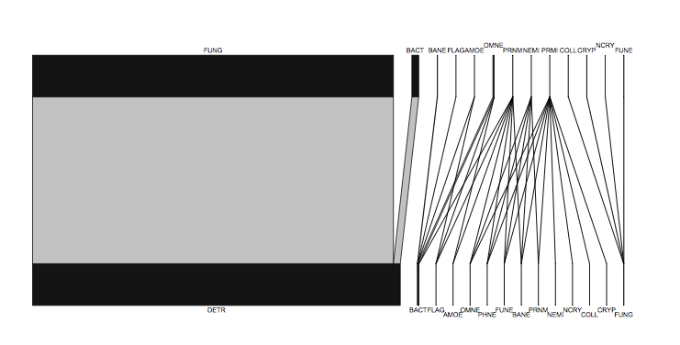
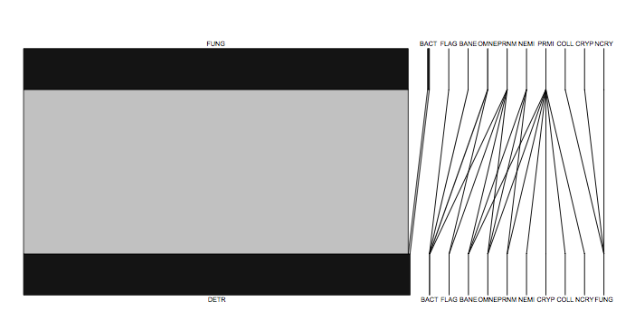
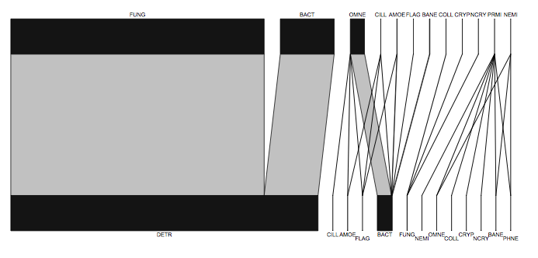
Fraser 0-10 cm
SGS 0-10 cm
Fraser 11-20 cm
SGS 11-20 cm

Slide 19
DISCUSSION

