Slide 1
SUMMER Soil Institute July 2010
Quantitative PCR Analysis of Forested and Shortgrass Steppe Soil Core Bacterial and Fungal Communities
Michael Schmidt
Nick Clements
Brian Ohsowski

Slide 2
Habitat Classification
Fraser Experimental Forest
Upper Montane / Subalpine Ecosystem
Elevation ranges from 8,800 to 12,804 ft
Conifers dominate the vegetative canopy
Average precipitation
70cm annually
¾ is snow fall

Slide 3
Habitat Classification
Shortgrass Steppe
Native grassland
Elevation: 5,200 - 5,500 ft
Main vegetation
grasses, succulents, and dwarf shrubs
Relatively dry climate due to the rain shadow effect of the Rocky Mountains
Seasonal rainfall (Apr – Sept)

Slide 4
What is PCR?
Polymerase Chain Reaction (PCR)
DNA based technique
Amplifies workable amounts of DNA copies from genes of interest
PCR has limitations………

Slide 5
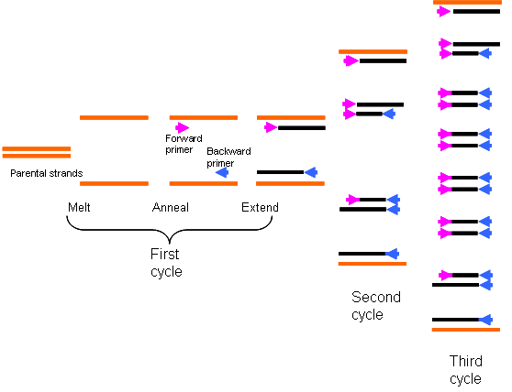
What is PCR?
How do PCR and qPCR differ?

Slide 6
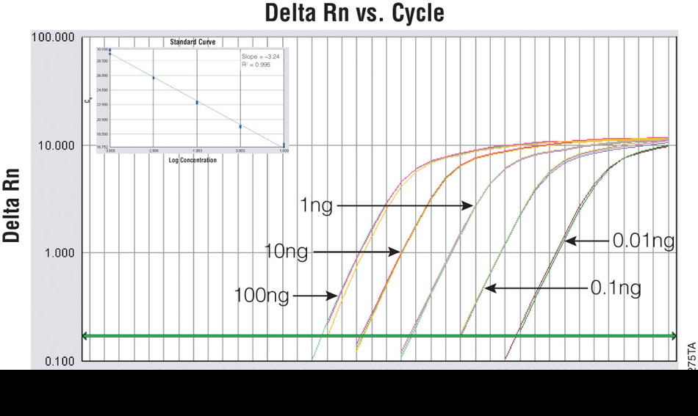
What is qPCR?

Slide 7
Methods
Extracted DNA from soil
DNA extraction kit
Mo Bio PowerSoil DNA Isolation Kit
Ran DNA gel
Agarose gel used to confirm DNA was present
Performed qPCR
Used to measure relative gene copy number for both fungi and bacteria
Three (3) subsamples run for each DNA soil extraction
Subsample copy number averaged at time of analysis

Slide 8
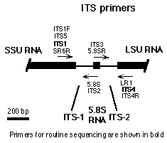
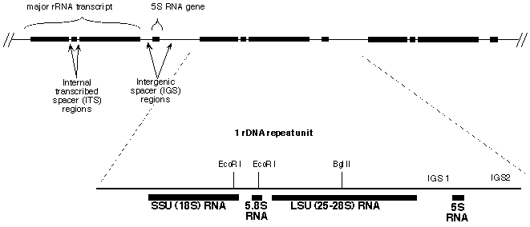
PCR Primers
General Fungal Primers
18s primer
Forward Primer = 1TS1F
Reverse Primer = 5.8S

Slide 9
PCR Primers
General Bacterial Primers
16s Primers
Forward Primer = Eub338
Reverse Primer = Eub518

Slide 10
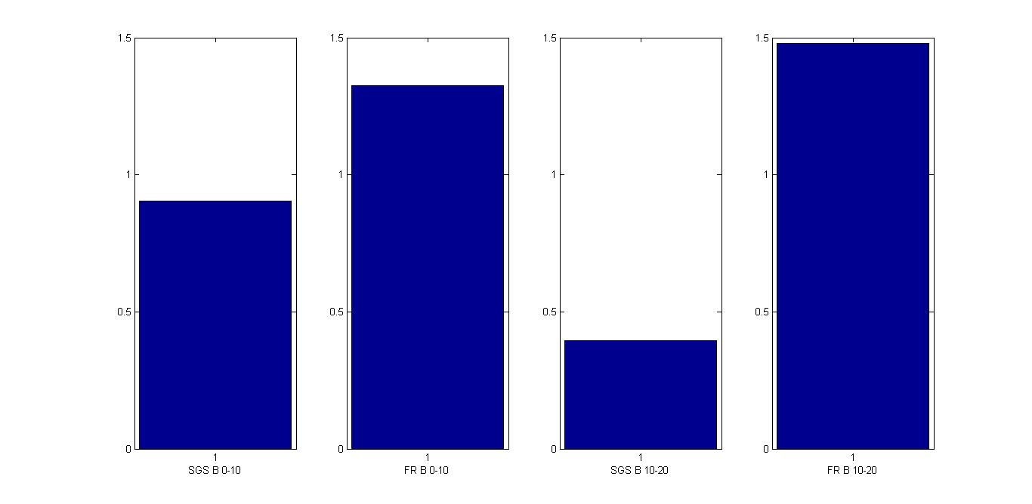
Results
Figure 1:Comparison of bacterial DNA extracted between sites and depth

Slide 11
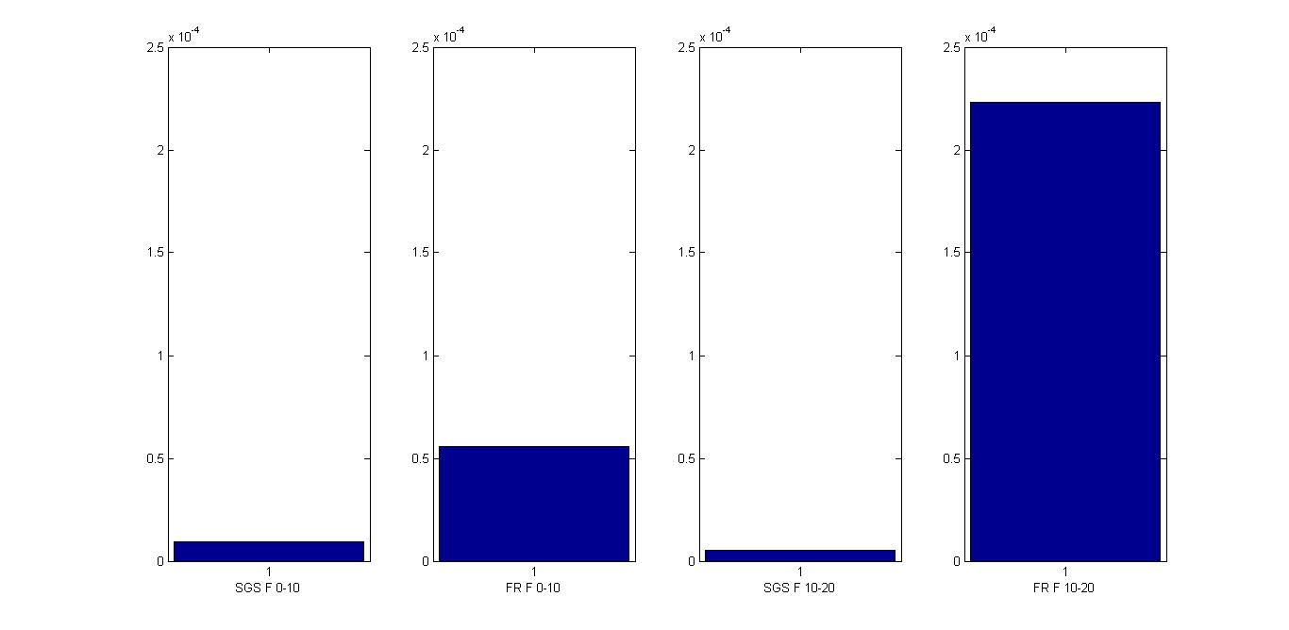
Results
Figure 2: Comparison of fungal DNA extracted between sites and depth

Slide 12
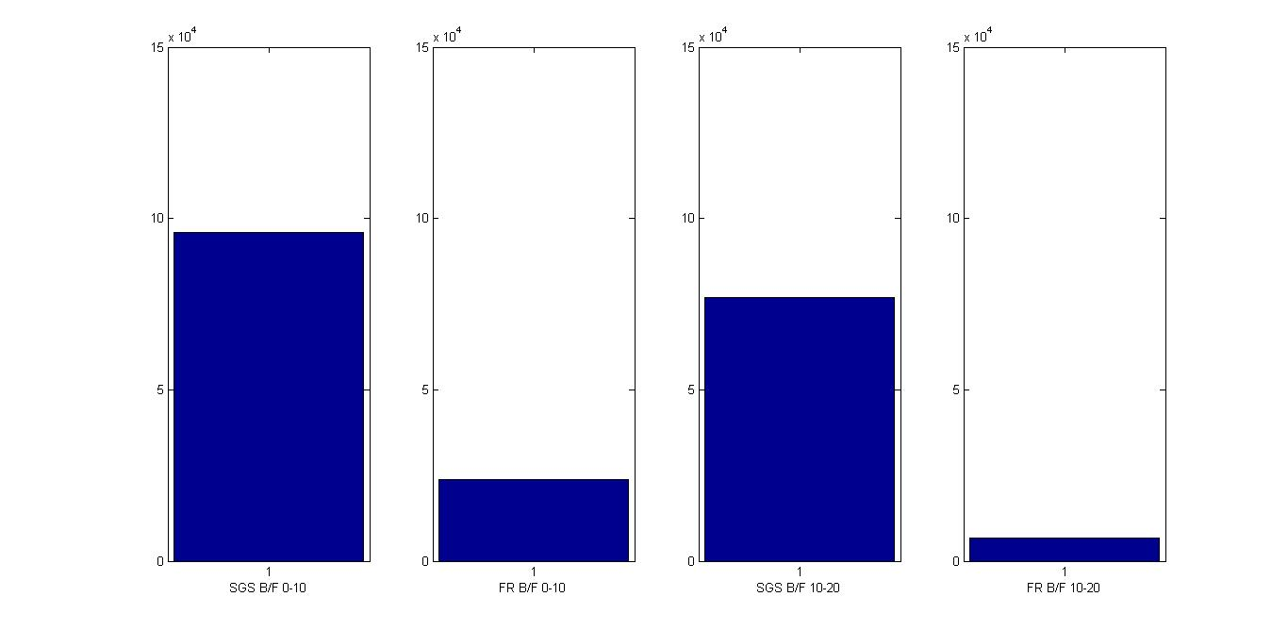
Results
Figure 3: Ratio of bacterial to fungal DNA for the different sites and depth

Slide 13
Conclusion
More DNA was extracted from Fraser soil then the SGS soil
True for both fungal and bacterial DNA
True for both depths sampled
More bacterial DNA was extracted from all sites and depths then fungal DNA
SGS sites had a higher bacterial to fungal DNA then Fraser

Slide 14
Thank you!!

