Slide 1
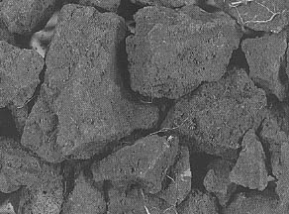
Pedology and Soil Chemistry
CSU Summer Soil Institute
23 July 2010
Claudia, Erin, Nam Jin and Dylan

Slide 2
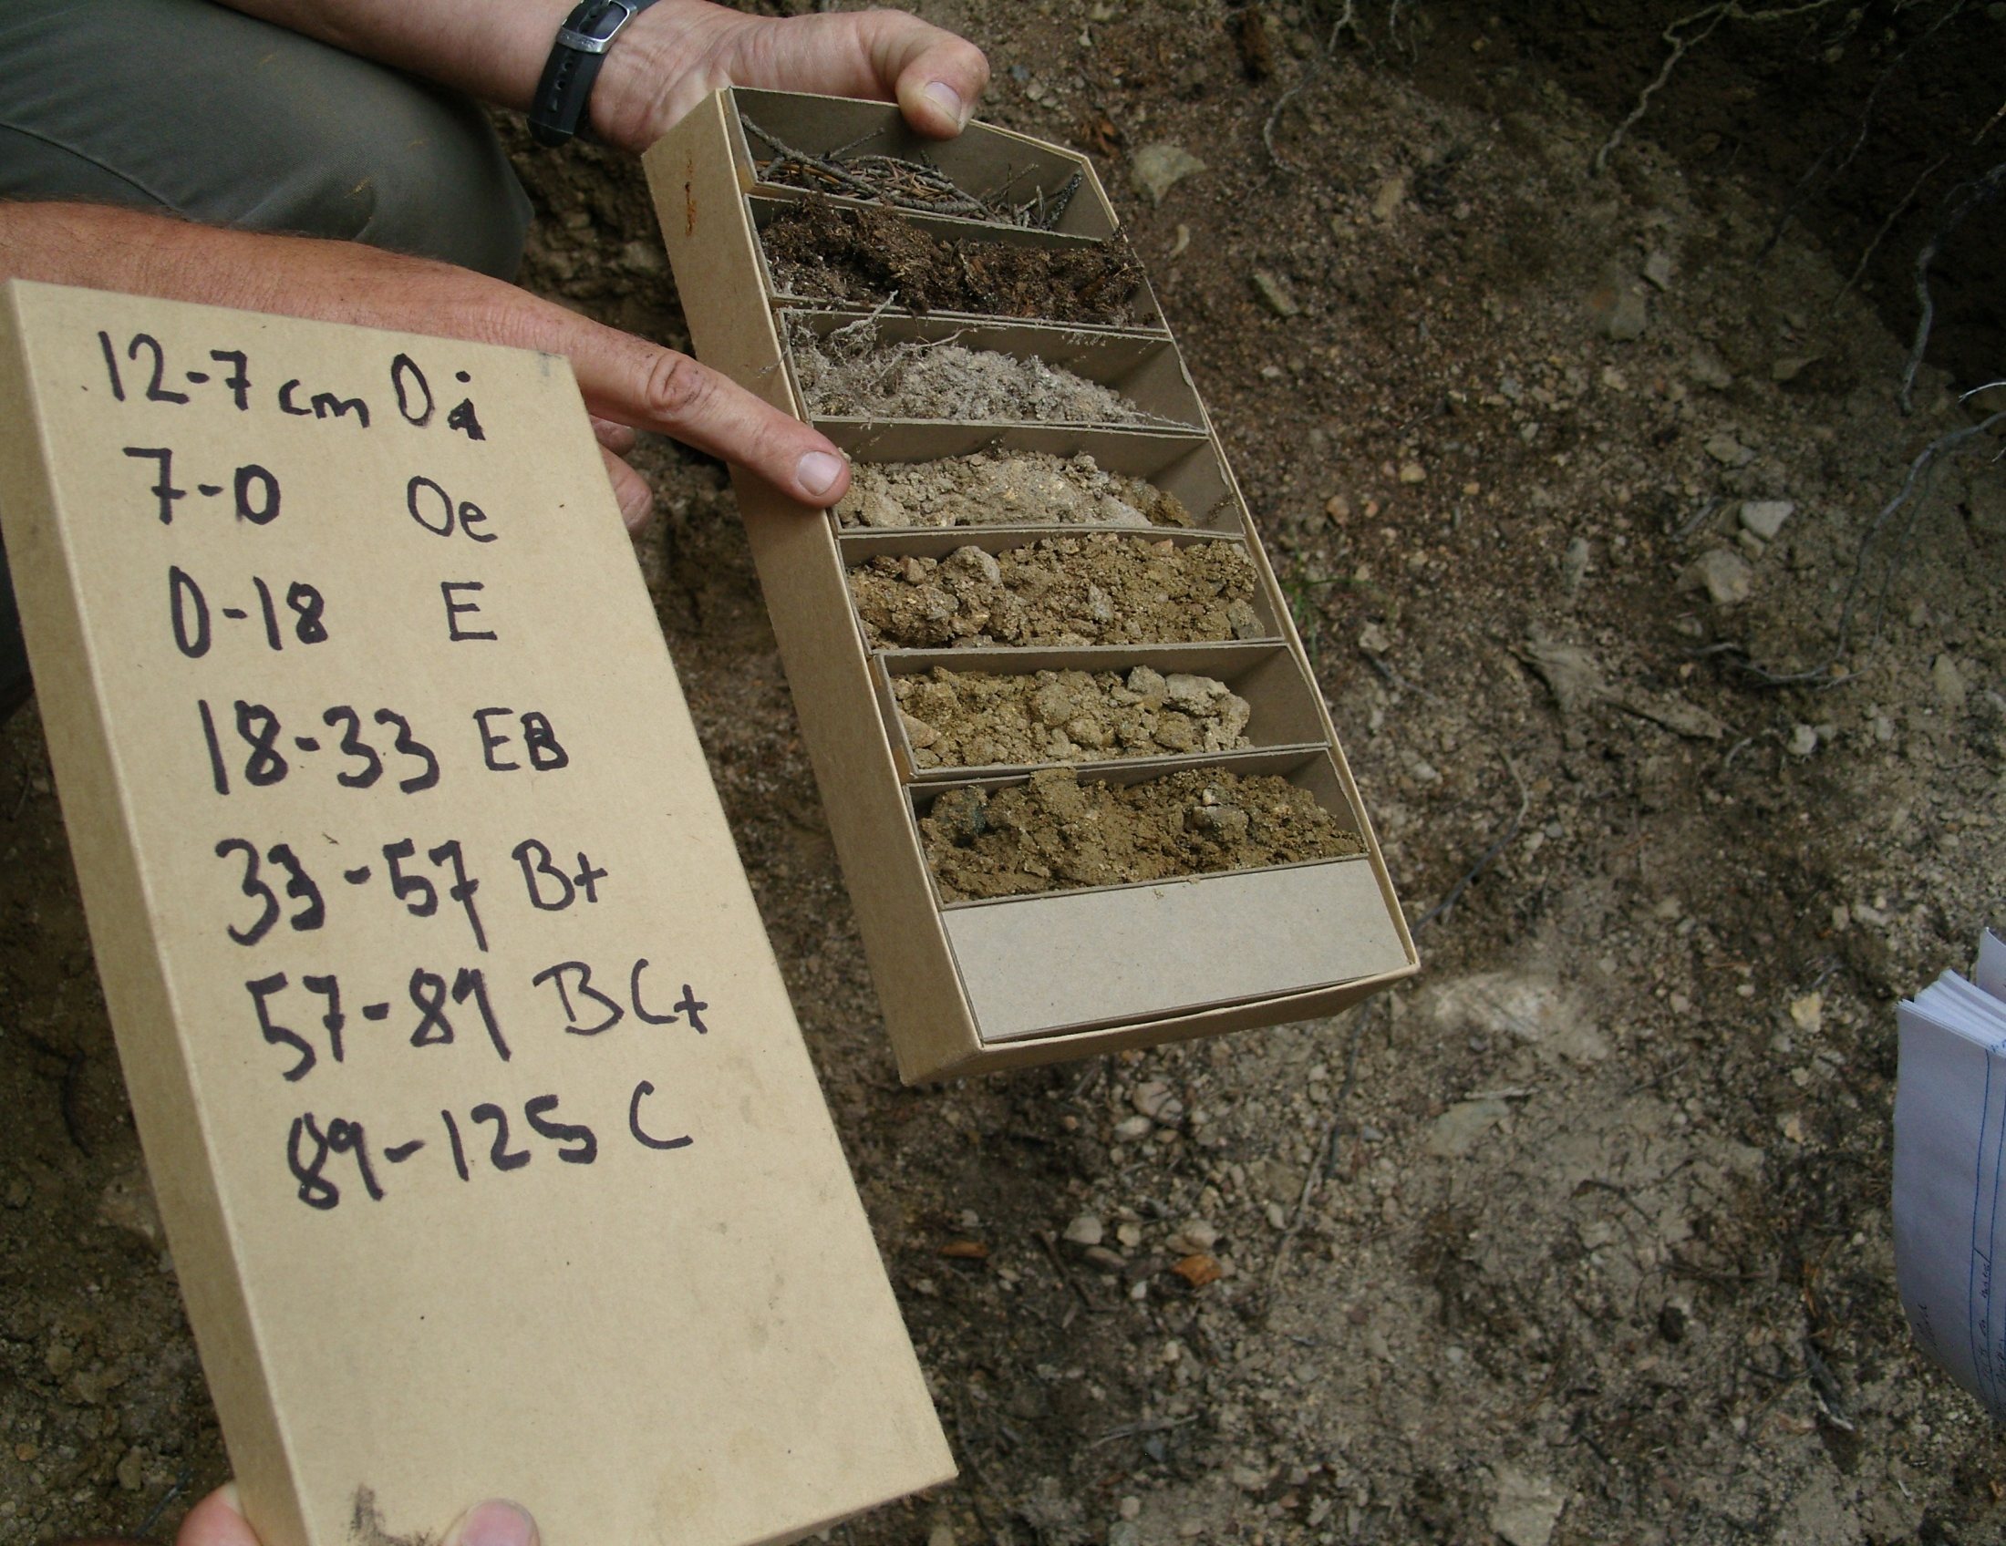
pedology
 | % N | %OC | C:N
FEF - O | 0.86 | 48 | 55.8
FEF 2-1 | 0.02 | 0.79 | 39.5
FEF 2-2 | 0.02 | 0.45 | 22.5
FEF 2-3 | 0.013 | 0.11 | 8.5
FEF 2-4 | 0.015 | 0.16 | 10.7
FEF 2-5 | 0.01 | 0.099 | 9.9

Slide 3
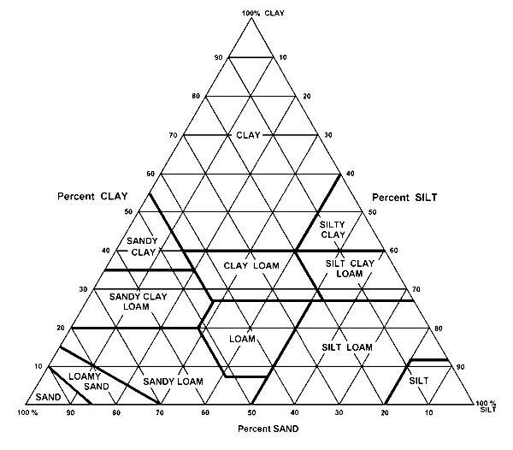
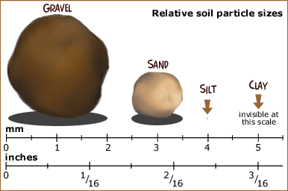
soil texture
Sand: 2 mm – .050 mm
Silt: .050 mm – .002 mm
Clay < .002 mm
http://school.discovery.com/schooladventures/soil/teacher_tips.html

Slide 4
texture
Particle size distribution analysis (PDSA)
> 2mm
Chemical dispersion w sodium hexaphosphate
Shake/stir
Hydrometer reading w/ time
May need to remove
Organic C (H2O2)
Fe (Na dithoinate)
Carbonate (NaOAc)
SGS—51% sand, 16% clay, 33% silt

Slide 5
X-ray diffractometry (XRD)
Diffraction pattern based on crystal structure of minerals
Use samples from texture analysis
Bulk soil
Quartz
Feldspar
Clay fraction
2:1 clays (2 tetrahedral sheets (Si)/octahedral (Al))
semectite
vermiculite
mica

Slide 6
mineralogy-XRD
FEF-E
FEF-Bt1
FEF-Bt1
Bulk soil: high quartz and feldspar w/ mica present

Slide 7
mineralogy-XRD
FEF-A
FEF-Bt1
FEF-BtK1
Clay fraction: mixed mineralogical composition dominated by the 2:1 clays but the presence of some poorly crystalline material as well.

Slide 8
total elemental analysis
sample prep
soil solution free of particulates
extraction
dissolution
acidification (HCl, HNO3)
analyses
ICP (inductively coupled plasma optical emission spectrometer)
hot, hot, hot—10000 K and gassy
energy absorbed=emission spectra

Slide 9
ANALYTE | Al2O3 | CaO | Cr2O3 | Fe2O3 | K2O | MgO | MnO | Na2O | P2O5 | SiO2 | TiO2 | Ba | Nb | Sr | Y | Zn | Zr | LOI | Sum
METHOD
DETECTION | 0.01 | 0.01 | 0.01 | 0.01 | 0.01 | 0.01 | 0.01 | 0.01 | 0.01 | 0.01 | 0.01 | 10 | 10 | 10 | 10 | 5 | 10 | 0.01 | 0.01
UNITS | % | % | % | % | % | % | % | % | % | % | % | PPM | PPM | PPM | PPM | PPM | PPM | % | %
FEF 2-1 | 12.8 | 0.78 | 0.04 | 4.67 | 2.65 | 1.37 | 0.04 | 1.34 | 0.09 | 67.9 | 0.6 | 560 | 30 | 130 | 60 | 85 | 250 | 5.6 | 98
FEF 2-2 | 13.6 | 0.75 | 0.03 | 5.6 | 2.75 | 1.72 | 0.05 | 1.21 | 0.1 | 66.4 | 0.6 | 540 | 40 | 120 | 50 | 95 | 240 | 5.2 | 98.1
FEF 2-3 | 13.6 | 0.75 | 0.02 | 5.57 | 2.71 | 1.71 | 0.05 | 1.27 | 0.1 | 66.1 | 0.6 | 540 | 40 | 120 | 60 | 98 | 250 | 6.5 | 99
FEF 2-4 | 15.3 | 0.79 | 0.02 | 6.81 | 2.9 | 2.09 | 0.06 | 1.27 | 0.12 | 60.7 | 0.68 | 560 | 40 | 130 | 60 | 110 | 270 | 4.6 | 95.5
FEF 2-5 | 15.3 | 0.84 | 0.02 | 6.57 | 2.9 | 2.07 | 0.06 | 1.33 | 0.12 | 64.3 | 0.64 | 570 | 40 | 130 | 50 | 107 | 280 | 3.7 | 97.9
ANALYTE | Al | Ca | Cr | Fe | K | Mg | Mn | Na | P | Si | Ti | Ba | Nb | Sr | Y | Zn | Zr | LOI | Sum
METHOD | ICP-95
DETECTION | 0.01 | 0.01 | 0.01 | 0.01 | 0.01 | 0.01 | 0.01 | 0.01 | 0.01 | 0.01 | 0.01 | 10 | 10 | 10 | 10 | 5 | 10 | 0.01 | 0.01
UNITS | % | % | % | % | % | % | % | % | % | % | % | % | % | % | % | % | % | % | %
FEF 2-1 | 6.77 | 0.56 | 0.03 | 2.06 | 2.20 | 0.83 | 0.03 | 0.99 | 0.04 | 33.97 | 0.36 | 0.06 | 0.00 | 0.01 | 0.01 | 0.01 | 0.03 | 5.6 | 98
FEF 2-2 | 7.20 | 0.54 | 0.02 | 2.47 | 2.28 | 1.04 | 0.04 | 0.90 | 0.04 | 33.22 | 0.36 | 0.05 | 0.00 | 0.01 | 0.01 | 0.01 | 0.02 | 5.2 | 98.1
FEF 2-3 | 7.20 | 0.54 | 0.01 | 2.46 | 2.25 | 1.03 | 0.04 | 0.94 | 0.04 | 33.07 | 0.36 | 0.05 | 0.00 | 0.01 | 0.01 | 0.01 | 0.03 | 6.5 | 99
FEF 2-4 | 8.10 | 0.56 | 0.01 | 3.01 | 2.41 | 1.26 | 0.05 | 0.94 | 0.05 | 30.37 | 0.41 | 0.06 | 0.00 | 0.01 | 0.01 | 0.01 | 0.03 | 4.6 | 95.5
FEF 2-5 | 8.10 | 0.60 | 0.01 | 2.90 | 2.41 | 1.25 | 0.05 | 0.99 | 0.05 | 32.17 | 0.38 | 0.06 | 0.00 | 0.01 | 0.01 | 0.01 | 0.03 | 3.7 | 97.9

Slide 10
mass balance
weathering + pedogenesis
net gains and losses
collapse—mineral dissolution
dilation—elemental additions
uses elemental analyses relative to immobile element
e.g. nomibium, zirconium

Slide 11
total elemental analysis
FEF-??
soil is dilating
while losing
elements
gaining Ca+
dust?

Slide 12
elemental mass transfer: -1.0 total loss, 0.0 no loss
80% Si retained
1o min
biotite
kaolinite
50% Fe
kaolinite & geothite
40% K retained
biotite

Slide 13
soil chemistry
NMR
intro
humic and fulvic acids
SEM
minerals
soils
surprises

Slide 14
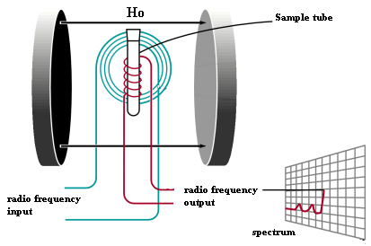
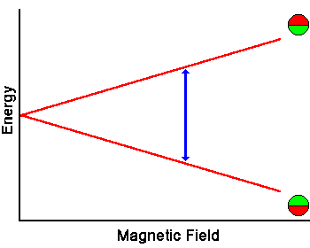
How NMR Works
spin number (I)
when I = ½ NMR spectra can be measured
¹H, ¹³C, ¹⁵N
place nuclei in magnetic field = B₀
nuclei will align with and against B₀
add energy and nuclei will ‘spin flip’

Slide 15

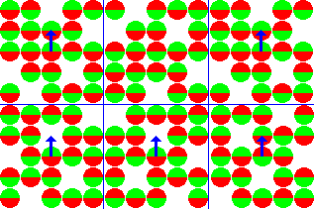
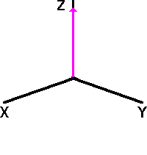


How NMR Works

Slide 16
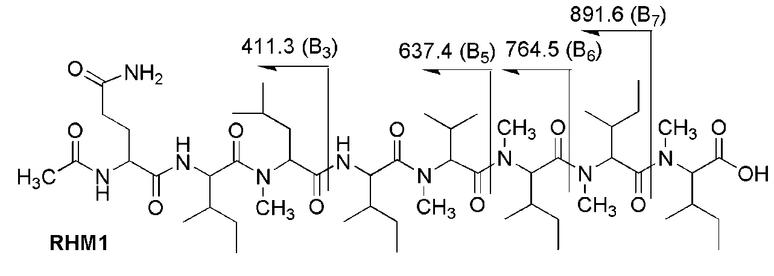
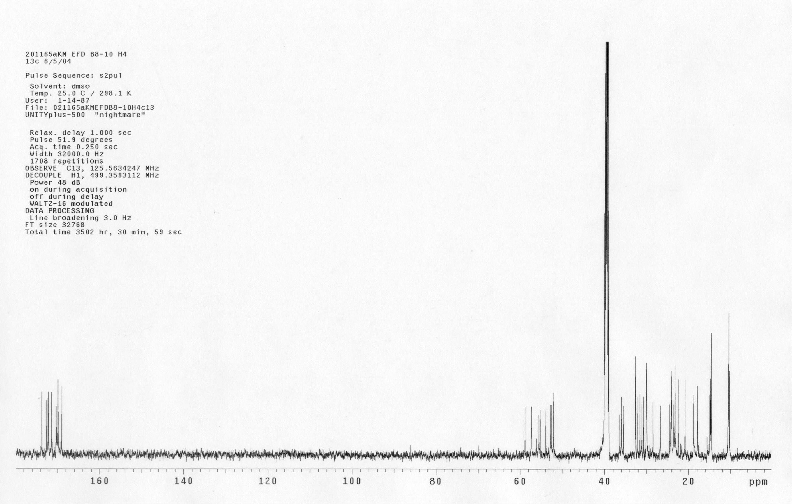
Balaria et al. 2009

Slide 17
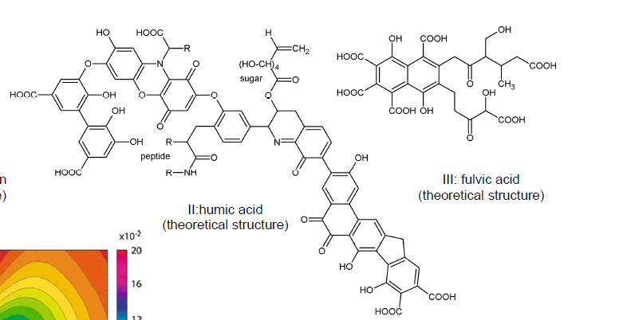

Slide 18
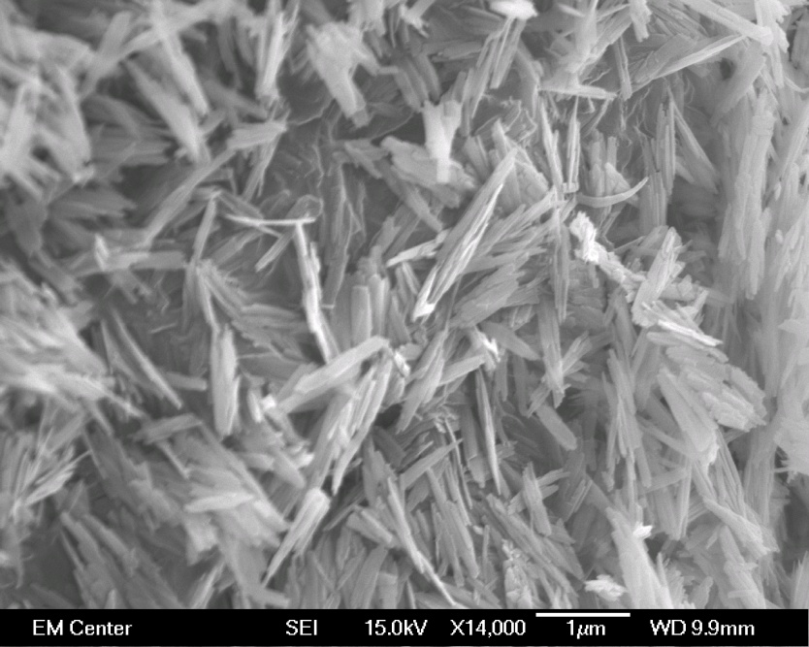
scanning electron microscopy (SEM)
schwertmannite
e- beam to visualize samples
large depth of field
electron column
e- source
magnetic lenses to de-magnify
magnetic coils to control beam
apertures to define beam
vacuum system
pumps
valves
detection and display
detectors
electronics
gold coat (sputter) samples
microgoethite

Slide 19
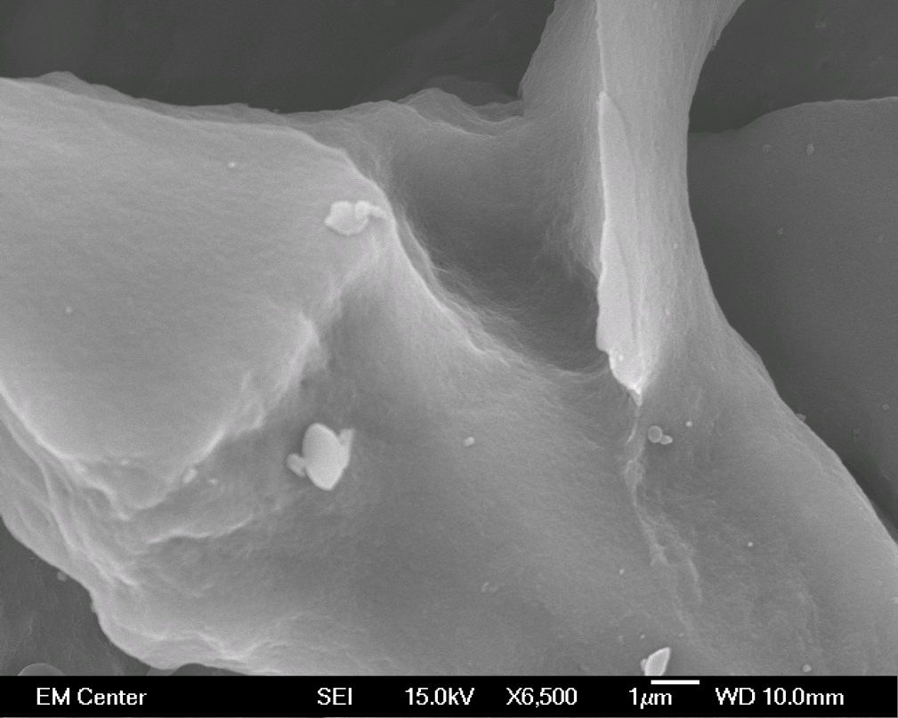
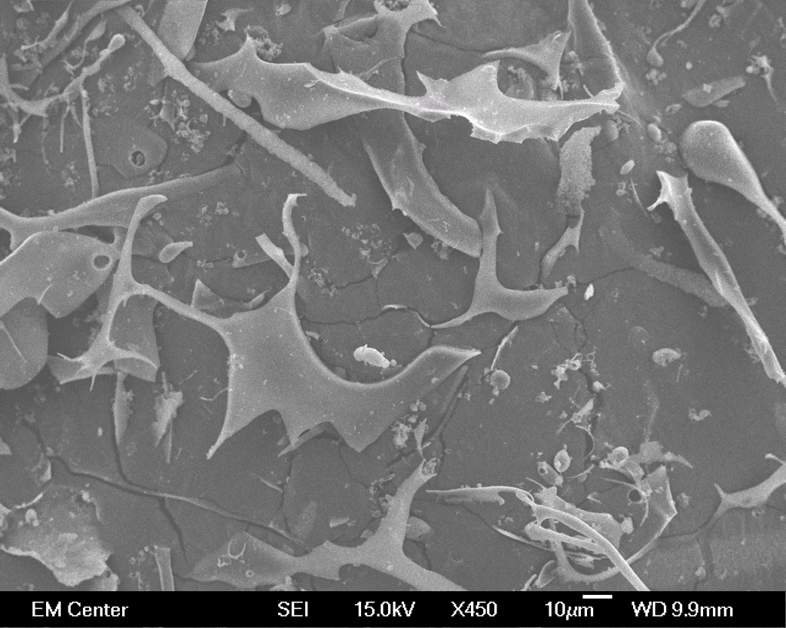
humic acid
fulvic acid

Slide 20
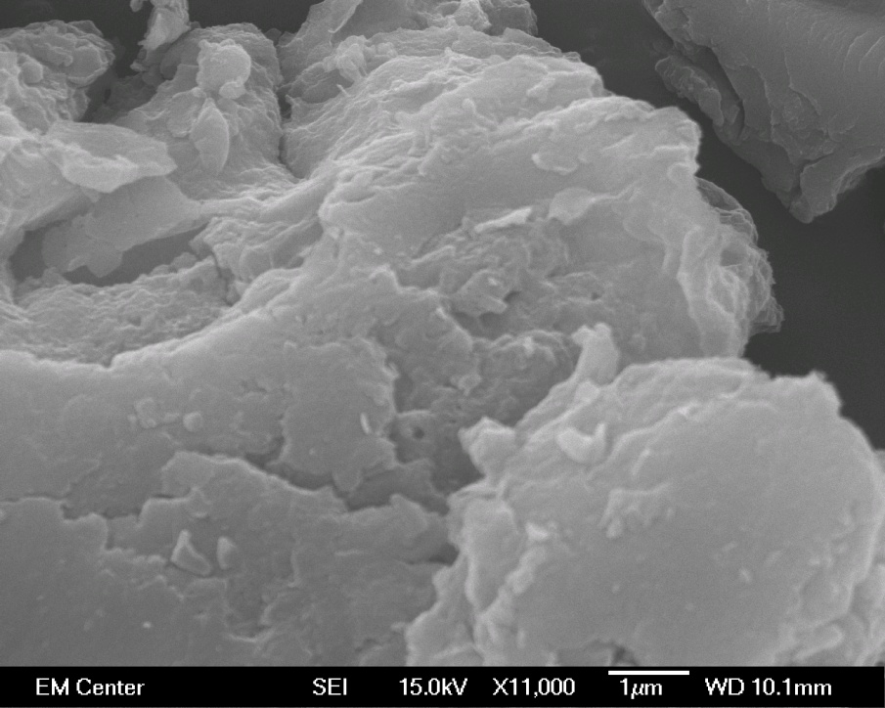
SGS soil
Fraser soil

Slide 21
?
EDS: electron dispersive spectroscopy—gives elemental composition of SEM image
iron sulfide!

Slide 22
conclusions
pedology is the foundation of soil science
texture
mineralogy
mass balance
soil chemistry is more than just acronyms
composition drives decomposition
lots ‘o tools to describe

