Slide 1
Emergence of Ecosystem Science
on the Global Scene
Jerry Melillo
The Ecosystems Center
Marine Biological Laboratory
Woods Hole, MA
Presented at a Symposium Honoring
Dennis Ojima
Ecosystem Science in the Anthropocene
Colorado State University
October 29, 2019
Notes:
More than seven decades ago, the issue of climate change public’s attention was drawn to climate change. During the late 1950s, Roger Revelle commented that humans were performing an unreplicated global experiment by raising the concentration of carbon dioxide (CO2) in our atmosphere with potentially serious, but unknown,consequences [1]. By 1960, working with Revelle, Dave Keeling [2] had shown that not only was the CO2 concentration increasing, but that one could also see a regular oscillation in its concentration that must be due to the photosynthesis of land plants in the temperate zone.

Slide 2
Factors Affecting Emergence of Ecosystem Science
on the Global Scene
ISSUES
ORGANIZATIONS
CONCEPTS
PEOPLE
NEW
TECHNOLOGIES
TIME
TIME

Slide 3
Human Domination of
Earth’s Ecosystems –
a 1997 perspective
Human alteration of Earth is substantial and growing.
more than $\frac{1}{2}$ of land surface transformed by human action
atmospheric CO₂ up by 48% since start of industrial revolution
more atmospheric nitrogen is fixed by humanity than by all natural terrestrial sources combined
more than half of all accessible
surface fresh water is put to use by humanity
about one-quarter of the bird species on Earth have been driven to extinction.
By these and other standards, it is clear that we live on a human dominated
planet.
Science (1997) 277:494-499,
doi: 10.1126/science.277.5325.494.

Slide 4
1950s
Climate change issue introduced to the public – R Revelle #
Early efforts to transform ecology in the US – GE Hutchison #
Systems ecology concepts being to mature – HT Odum, G Odum
Time Magazine - May 18, 1956
“One Big Greenhouse”
“Since the start of the industrial revolution, mankind has been burning fossil fuel (coal, oil, etc.) and adding its carbon to the atmosphere as carbon dioxide. In 50 years or so, says Director Roger Revelle of the Scripps Institution of Oceanography, this process may have a violent effect on the earth's climate.“
Roger Revelle
Roger Revelle
National Medal of Science
1990

Slide 5
Climate change issue introduced to the public – R Revelle #
Early efforts to transform ecology in the US – GE Hutchison #
Systems ecology concepts begins to mature – HT Odum, G Odum
1950s
“In the pre-Hutchinsonian formulation, ecology and natural history were essentially identical. After Hutchinson, ecology took a new multi-level complexity. It had become legitimate to study physical or chemical properties of ecosystems in their own right. This basically biogeochemical notion had existed in Russia, but Hutchinson brought it west.’ - Larry Slobotkin
In lecture and papers, Hutchinson introduced the the idea of "Circular Causal Systems" - the tight link between biological and physical processes, and that the activity of organisms balanced the effects on the cycles of chemicals through organisms. He argued that the changes in biological productivity were related to the changes of available nutrients. He stated that the condition in which organisms existed were systems of feedback loops. In his systems view, there were both living and non-living feedback loops which followed the same basic principles. This idea led to the development of systems ecology by his student H.T. Odum and H.T.’s brother, Gene. They were soon followed by others including George Van Dyne, NREL’s founder.
G.E. Hutchinson
Begining in the mid-1940s,
Hutchinson regularly
included climate change
discussions in his ecology
classes at Yale

Slide 6
1960s
G Van Dyne articulates vision of systems ecology in ORNL report - 1966 #
IBP – established in 1964, ran through 1974
NSF Ecosystems Program – established in 1969
“There has been a gradual but distinct shift in
emphasis in ecological studies and training
from the description and inventory of ecosystem …
to the study of energy flow, nutrient cycles, and
productivity of ecosystems. More workers are
extending knowledge from the “anatomy” to the
“physiology” of the environment. This requires
different concepts, tools and methods.”
Left to Right top row: Norm French,
Jim Gibson, George Van Dyne, Melvin Dyer;
Front Row: Freeman Smith, George Innis
“Systems ecology will call for an interdisciplinary
team of systems ecologists, systems analysts and
operations researchers ( if they can be separated),
conventional ecologists, mathematicians, computer
technologists, and applied ecologists, including
agriculturalists and natural resource managers
of various disciplines."
Ecosystems,
Systems Ecology and
Systems Ecologists

Slide 7
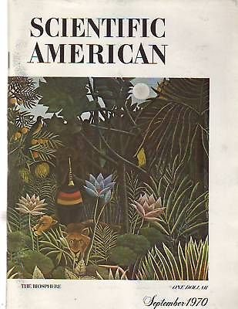
1970s
- Scientific American - The Biosphere –GE Hutchison et al. – September 1970 #
- B. Bolin begins Global Carbon Cycle Program at SCOPE - 1979 #
G. Evelyn Hutchinson The Biosphere
Abraham H. Oort The Energy Cycle of the Earth
George M. Woodwell The Energy Cycle of the Biosphere *
H. L. Penman The Water Cycle
Preston Cloud and Aharon Gibor The Oxygen Cycle
Bert Bolin The Carbon Cycle *
C. C. Delwiche The Nitrogen Cycle
Edward S. Deevey, Jr. Mineral Cycles
Lester R. Brown Human Food Production as a Process in the Biosphere
S. Fred Singer Human Energy Production as a Process in the Biosphere
Harrison Brown Human Materials Production as a Process in the Biosphere

Slide 8
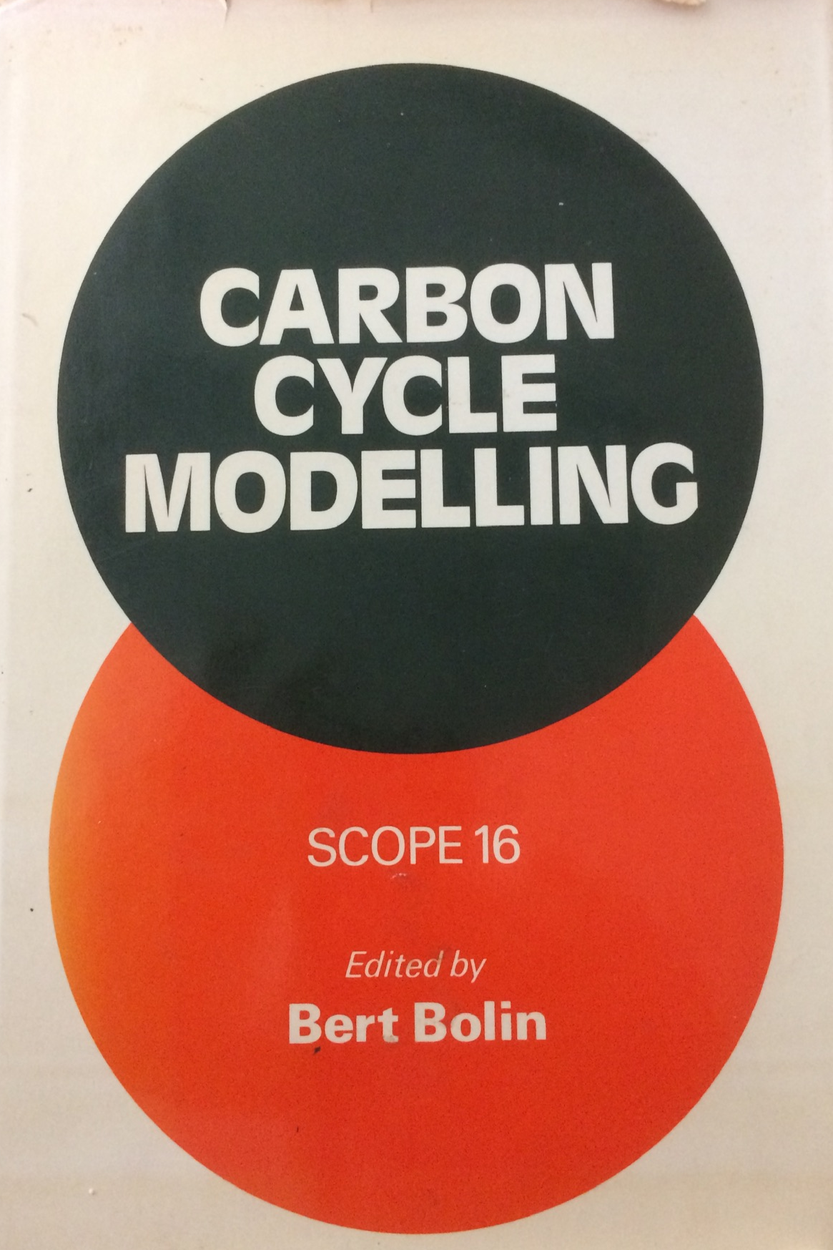
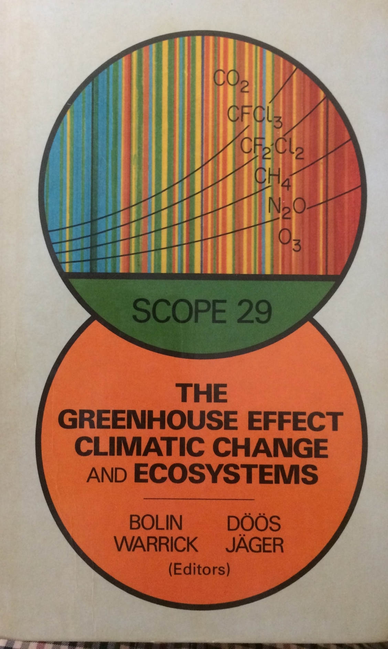
1970s
- Scientific American - The Biosphere –GE Hutchison et al. – September 1970 #
- B. Bolin begins Global Carbon Cycle project at SCOPE - late 1970s #
Bert Bolin
SCOPE 13
Bolin (ed.) 1979
SCOPE 16
Bolin et al. (eds.) 1981
The importance of systems ecology in
global carbon cycle scholarship recognized
early in SCOPE
SCOPE 29
Bolin et al. (eds.) 1986

Slide 9
- NASA images – Landsat images documenting land-use change in Amazon #
- First global model of role of land ecosystems in the C cycle – 1982 #
- Major Biogeochemical Cycles and Their Interactions published – 1986 #
- Large non-governmental and governmental programs established to foster
global change science and the assessment of climate change #
- Eddy flux technology first employed in forests to measure ecosystem net
C balance - 1989
1980s
MBL develops a “book-keeping model” based
on changes in carbon stock patterns over time
and space
Approach
“quantify” areas disturbed
“document” fate of disturbed area
”specify” patterns of plant and soil C
dynamics over time
Global Deforestation: Contribution to Atmospheric Carbon Dioxide
G. M. Woodwell et al. , Science 09 Dec 1983, DOI: 10.1126/science.222.4628.1081
Intellectual partners:
Ecologists, Foresters, Agronomists,
Soil Scientists, Geographers, Historians,
Remote Sensing specialists, GIS specialists,
Mathematiians
Deforestation in Rondonia mid-1970s
and beyond – Landsat MSS

Slide 10
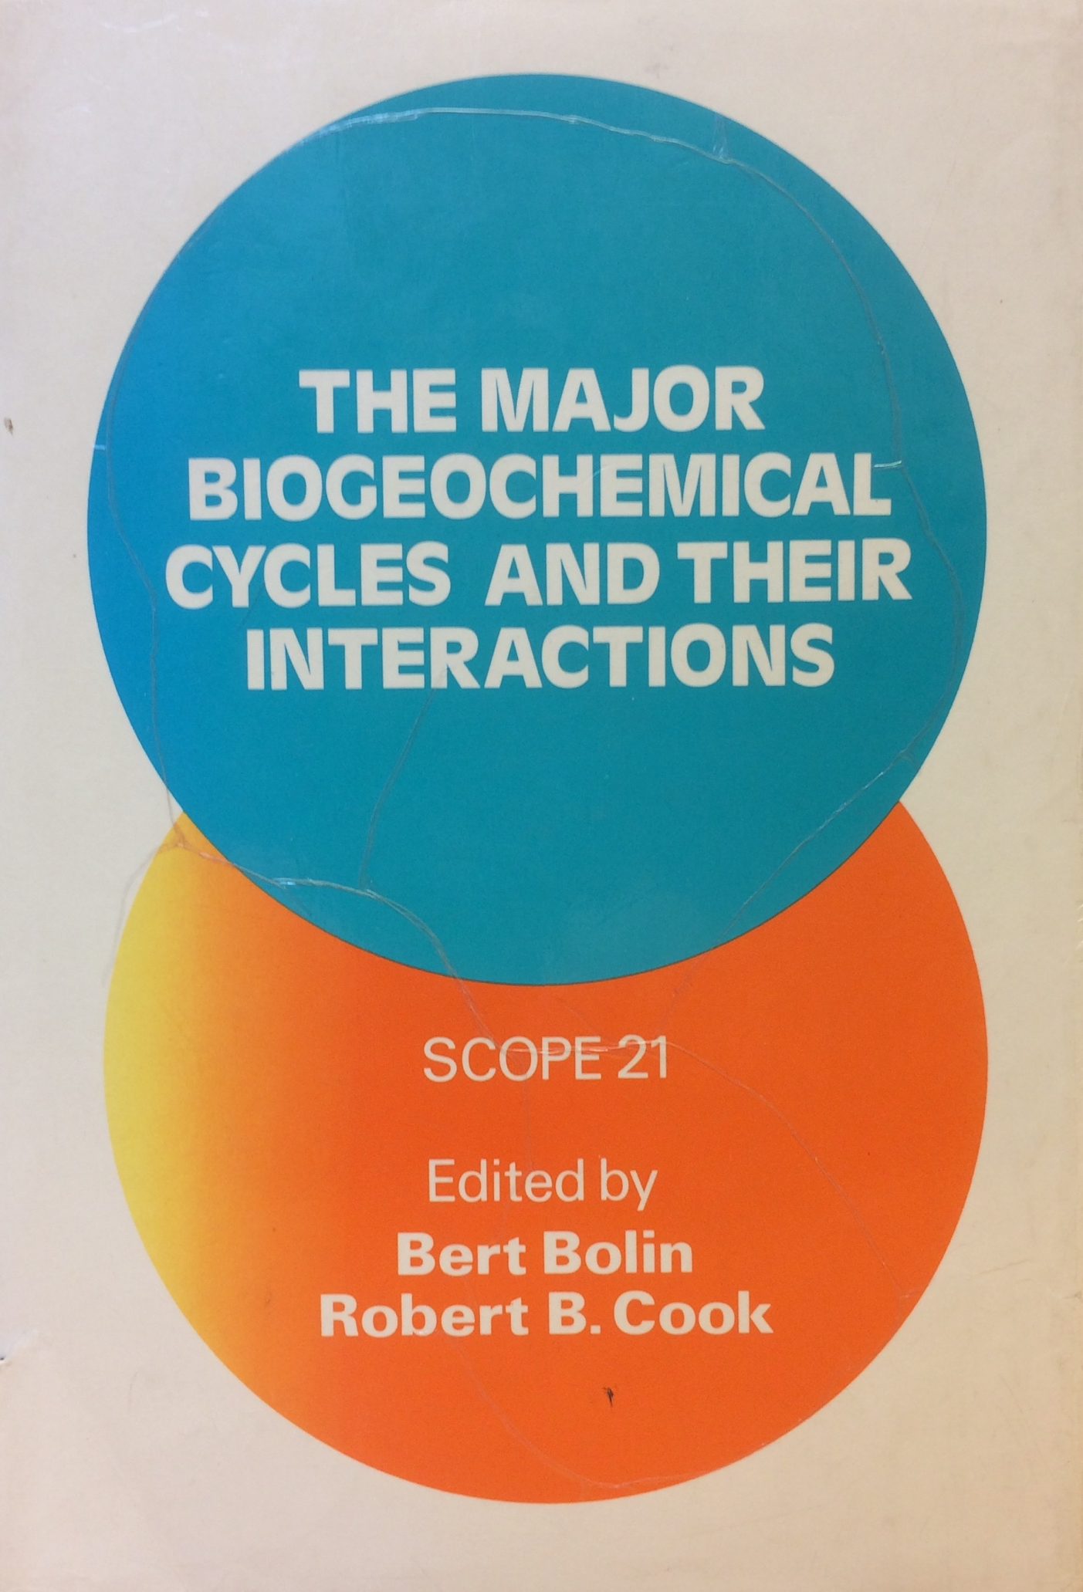
- NASA images – Landsat images documenting land-use change in Amazon
- First global model of role of land ecosystems in the C cycle - 1982
- Major Biogeochemical Cycles and Their Interactions published in – 1986
- Large non-governmental and governmental programs established to foster
global change science and the assessment of climate change
- Eddy flux technology first employed in forests to measure ecosystem net
C balance - 1989
1980s
A major Role Played by
the Prairie Boys
Thomas Rosswall
Secretary-General, SCOPE (1986-1988);

Slide 11
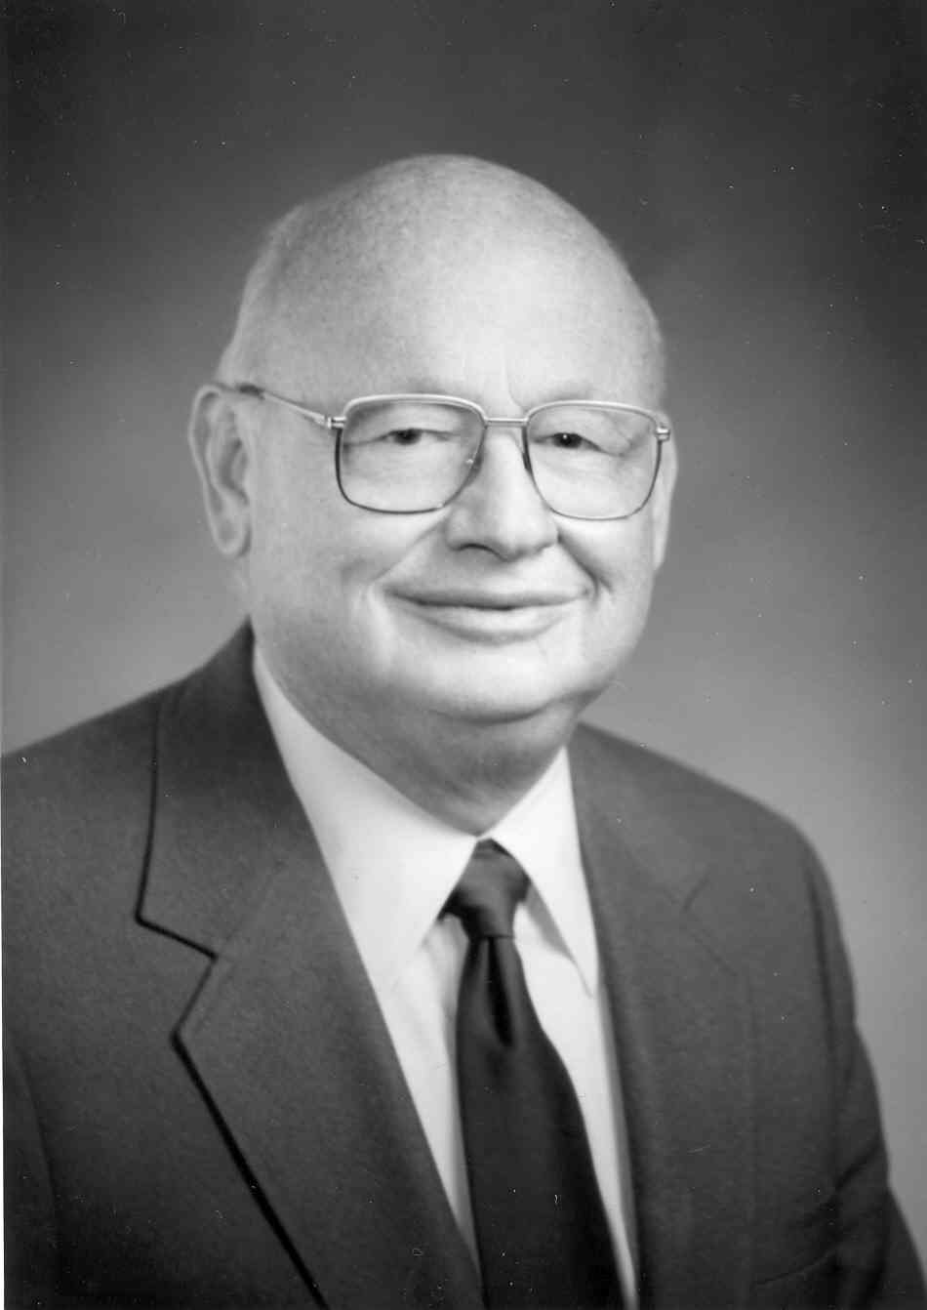
“The Prairie Boys”
Francis Clark
Ted Elliot
Vern Cole
Dave Coleman
Bill Parton
Bill Hunt
Tom Callahan and
Bob Woodmansee
JWB Stewart
so many others
William McGill
Eldor Paul
Holm Tiessen
and many others

Slide 12
1980s
- NASA images – Landsat images documenting land-use change in Amazon #
- First global model of role of land ecosystems in the C cycle – 1982 #
- Major Biogeochemical Cycles and Their Interactions published in – 1986 #
- Major governmental and non-governmental programs established to foster
global change science and the assessment of climate change #
- Eddy flux technology first employed in forests to measure ecosystem net
C balance - 1989
- WMO and UNEP organize an Intergovernmental Panel on
Climate Change (IPCC) – 1987
1988--1997
International Council of Scientific Unions (ICSU) launches
International Geosphere Biosphere Program (IGBP) – 1987
Both IPCC and IGBP fostered international
collaborations across the
Earth Sciences including Ecosystem Science
1987-1992

Slide 13
USGCRP established by an act of Congress coordinate global change research in US – 1990 #
- First global biogeochemistry models – diagnostic and prognostic #
- Prototype Free Air Circulation Experiment established at Duke Forest
- Long-term soil warming studies established in montane, grassland
and forest ecosystems
1990s
Shelby Tilford
NASA
Assistant Administrator for Mission to Planet Earth
Robert Corell
NSF
Associate Director,
Geosciences Program
Mike Hall
NOAA
Director
Climate Program Office
Budgets in support of global change science grow rapidly
once the Global Change Research Act becomes law

Slide 14
1990s
- USGCRP established by an act of Congress coordinate global change research # - First global biogeochemistry models – diagnostic and prognostic #
- Prototype Free Air Circulation Experiment established at Duke Forest
- Long-term soil warming studies established in montane, grassland
and forest ecosystems
Vegetation/Ecosystem Modeling and Analysis Project (VEMAP)
CENTURY Modeling Team
- 3 biogeochemistry models
- 3 biogeography models
- 26 participants from US and
European institutions
NASA and EPRI funding
Bill Parton
Dave Schimel
Dennis Ojima
Tony Janetos
Lou Pitelka

Slide 15
2000s
- Millennium Ecosystems Assessment (MA) launched – 2001 #
- Earth System Models that include economic drivers developed #
The Millennium Ecosystem Assessment (MA) assessed the consequences of ecosystem change for human well-being. From 2001 to 2005, the MA involved the work of more than 1,360 experts worldwide. Their findings provide a state-of-the-art scientific appraisal of the condition and trends in the world’s ecosystems and the services they provide, as well as the scientific basis for action to conserve and use them sustainably.
Walt Reed

Slide 16
2000s
Millennium Ecosystems Assessment (MA) launched – 2001 #
Earth System Models that include economic drivers developed #
MIT’s Integrated Earth Systems Model

Slide 17
Current
Decade
- National Science Board and Congress approved funds to build NEON – 2011#
- Genomics tools become part of the ecosystem scientists’ kit
- Microbial processes are becoming better integrated into Earth System Models
- Future Earth is established – 2012
"The mission of the National Ecological Observatory Network (NEON) is to enable understanding and forecasting of the impacts of climate change, land use change, and invasive species on continental-scale ecology -- by providing infrastructure and consistent methodologies to support research and education in these areas."

